Slide 1
Presentation Skills
www.chrisbauman.com.au

Slide 2
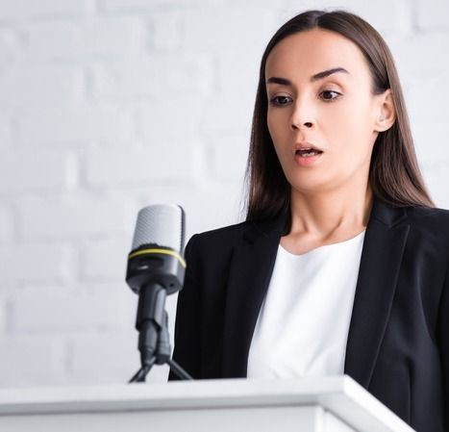
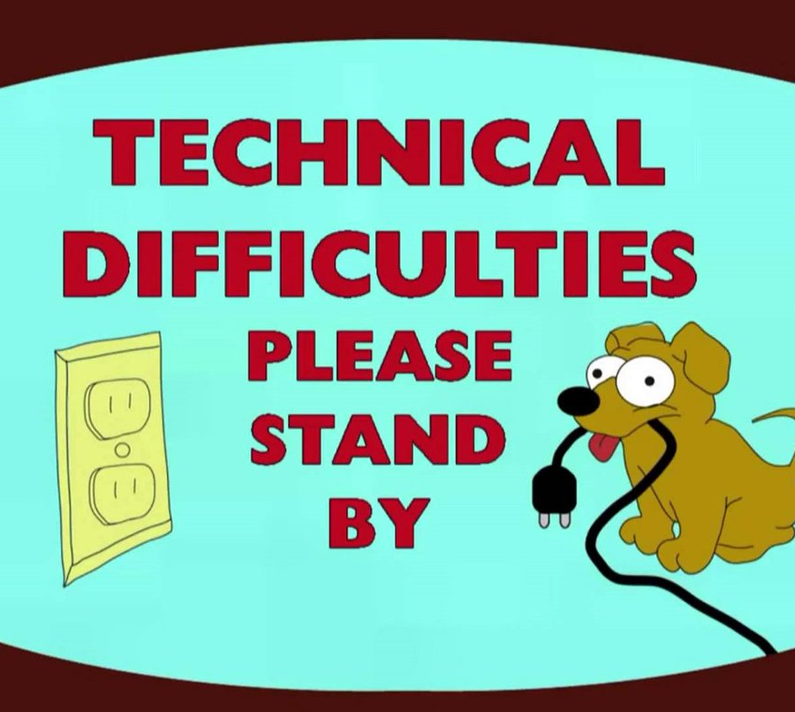
Problems?

Slide 3
Reminder …. 1. Teamwork

Slide 4
Reminder …. 2. Personal Growth

Slide 5
Body Audit (posture)
Smaller
Crossing your legs
Wrapping your ankles
Spread out
Crossing your arms
Facial expression
What is your body language communicating?
Discuss
www.chrisbauman.com.au

Slide 6
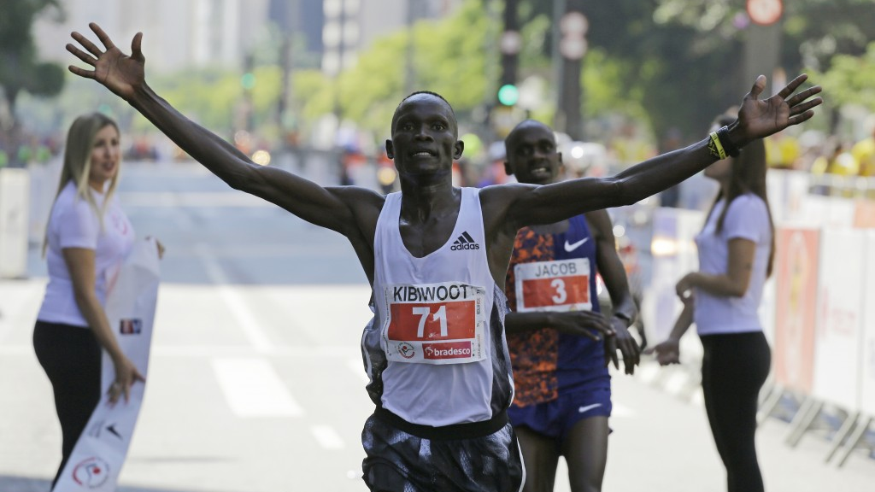
www.chrisbauman.com.au

Slide 7
Psychology
1. Our minds change our bodies
2. Our bodies also change our minds
www.chrisbauman.com.au

Slide 9
1. Look at the audience
10 rules

Slide 10
2. Wait for quiet
10 rules

Slide 11
3. Organize your Speech
10 rules

Slide 12
4. Work with words
10 rules

Slide 13
5. Gestures
10 rules

Slide 14
6. Use vocal variety
10 rules

Slide 15
7. Be sincere
10 rules

Slide 16
8. Add impact
10 rules

Slide 17
9. Inspire your audience
10 rules

Slide 18
10. Persuade with power
10 rules

Slide 20
Practice Tips
1. Record yourself
www.chrisbauman.com.au

Slide 21
Practice Tips
2. Practice losing your place is you memorize
www.chrisbauman.com.au

Slide 22
Practice Tips
3. Practice with your slides

Slide 23
Practice Tips
4. Get a friend to help you

Slide 24
Practice Tips
5. Smile
When you smile you look confident

Slide 25
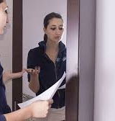
Practice Tips
6. Practice speaking in front of a mirror

Slide 26
Practice Tips
7. Think of some rhetorical questions that the audience may ask.
What do they want to learn about?

Slide 27
Try to think this way
Respect
Trust
Personal learning
Be prepared
Help someone else
www.chrisbauman.com.au

